Slide 1


St. Padarn’s RC Primary School’s research enquiry
As we follow in Jesus' footsteps, we grow in faith, love and learning.
Does attainment in writing standards increase following the teaching of Higher Order Reading skills (HORs)?

Slide 2
What we wanted to find out:
Do the pupils know about the Reciprocal Teaching Model and the four Higher Order Reading Skills (HORS) of questioning, clarification, predicting and summarizing?
After being taught these four HORS, will the pupils be able to apply them when researching for a writing task?
How do the children feel about using the process of writing using the RTM?
Does using the RTM increase pupil perception of their ability in regards to writing?

Slide 3
Background literature, the argument for use of the Reciprocal Teaching Model to progress writing.
‘The RT model can be used to emphasize the writing process, revising and
giving feedback on students’ writing which leads to a meaningful interaction
between teachers and students. Another advantage of the RT model is its
learner-centeredness nature that puts students in the center of the construction of the meaning they want to convey.
Considering that students are the main characters of the learning process, the institutional policies should implement this kind of innovation and adaptations to teaching methods that impact the English teaching and the learning process as well. Due to these reasons,the researchers recommend adopting the RT model to positively impact the students’ writing skills.’
Karen Julio Cárdenas and Margarita María López Pinzón (July – December, 2019), ‘The Reciprocal Teaching Model in the Development of Writing in Tenth Graders’, Gist Education and Learning Research Journal, No.19, pp. 128-147

Slide 4
Higher Order Reading Skills*:
Predicting
Questioning
Clarification
Summarising
*Karen Julio Cárdenas and Margarita María López Pinzón (July – December, 2019), ‘The Reciprocal Teaching Model in the Development of Writing in Tenth Graders’, Gist Education and Learning Research Journal, No.19, pp. 128-147.

Slide 5
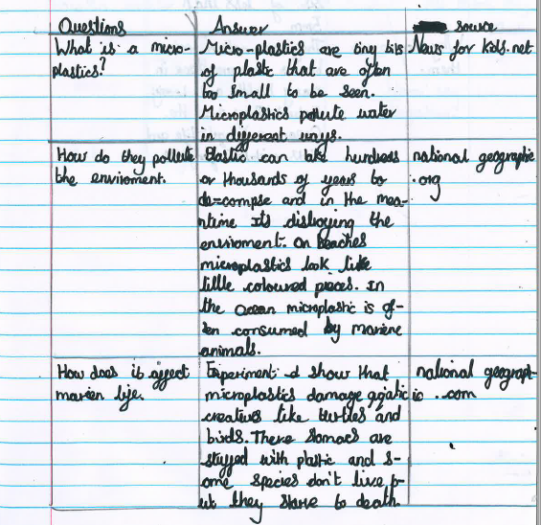
How we taught the HORs:
The skills were taught through a cross-curricular approach. We studied and used the skills in English, Topic and guided reading lessons, through a range of non-fiction and fiction literature.

Slide 6
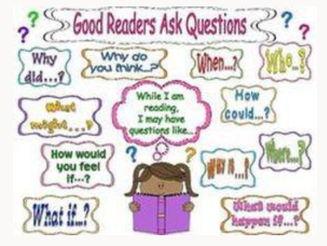
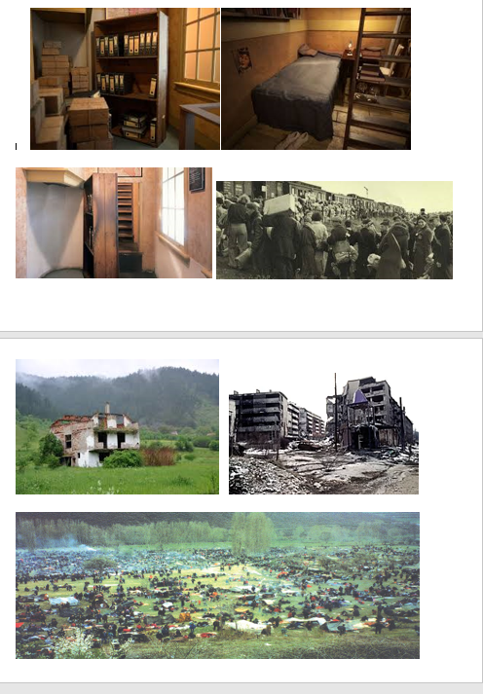
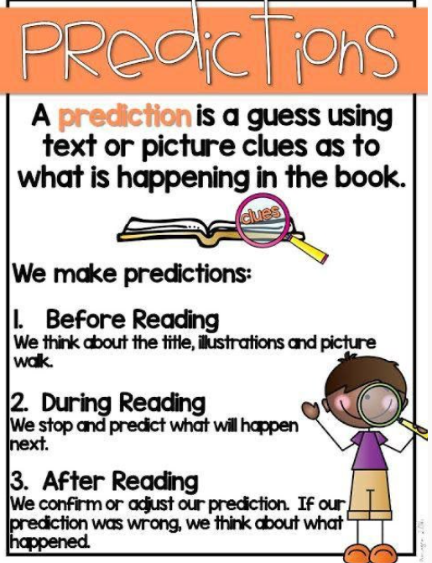
Prediction and Questioning
We were asked to make questions and predictions on the photographs. We then read the linked resources, discussed the answers and any changes and whether the predictions were correct.
Pupil Predictions
Pupil Resources

Slide 7
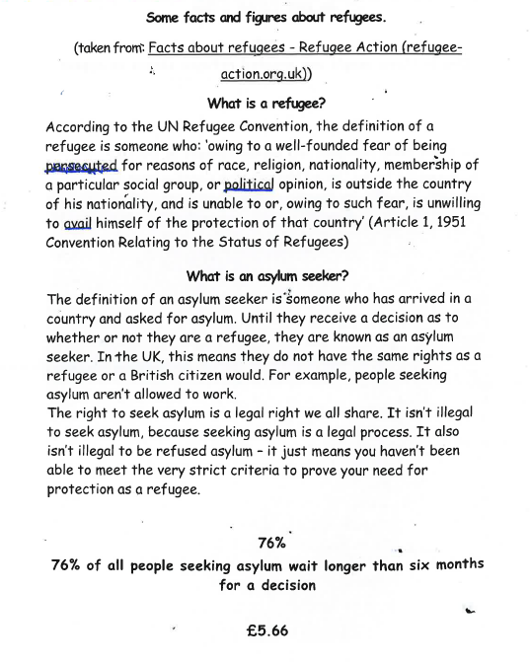
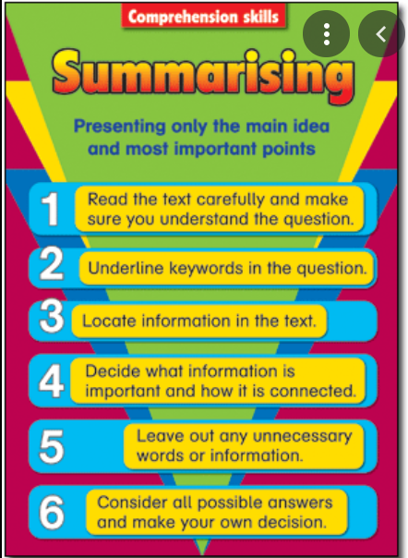
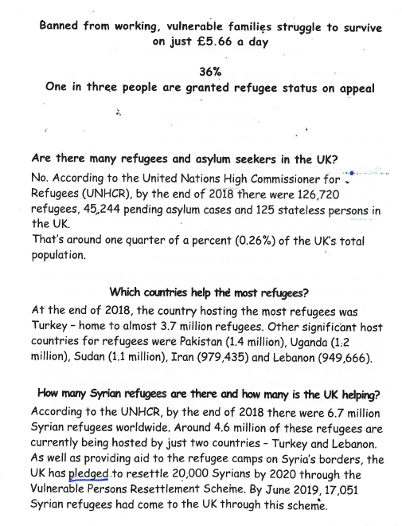
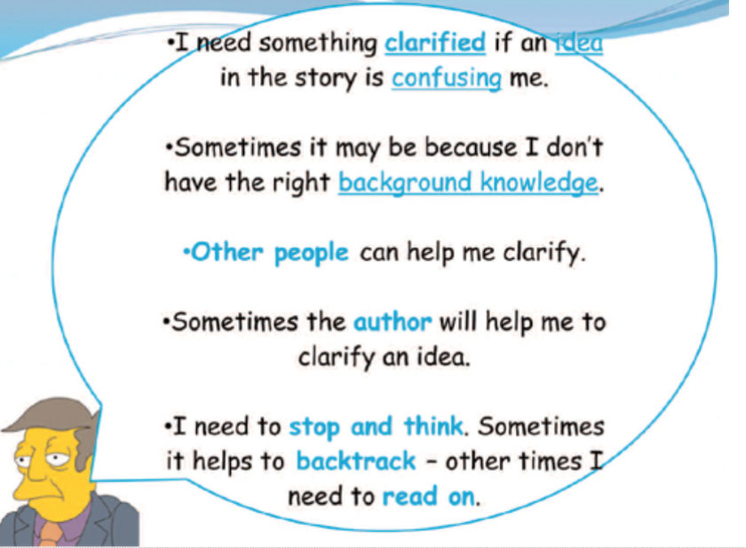
Clarification and Summarising
We read the text, noting words or phrases that we were unsure of. We then worked in pairs to clarify the meanings of these words and phrases.
After clarifying, we summarised the
information we had researched and clarified, using our summarising skills.

Slide 8
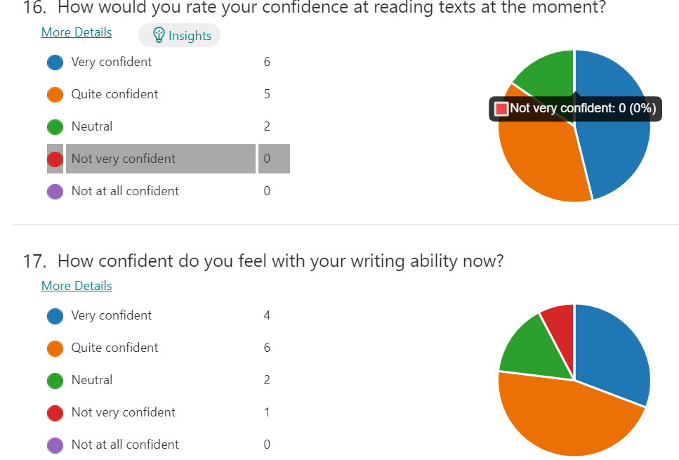
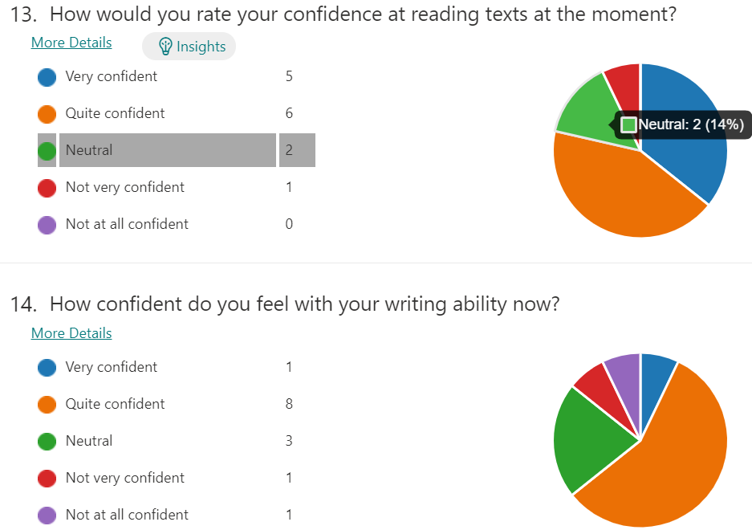
Research methods:
Pre, mid and post-questionnaires for a focus group of children.
Pupil focus group interviews.
Assessing the writing of a focus group of children through three writing tasks, looking at their progress using levels.

Slide 9
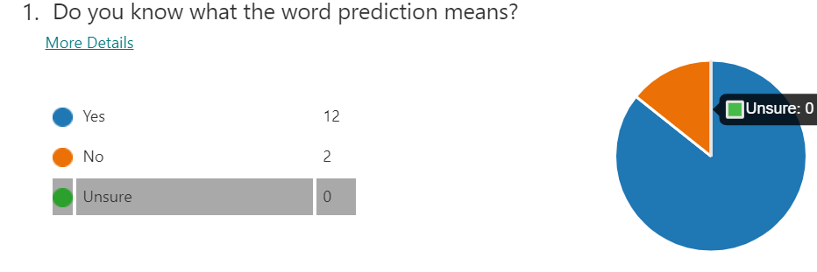
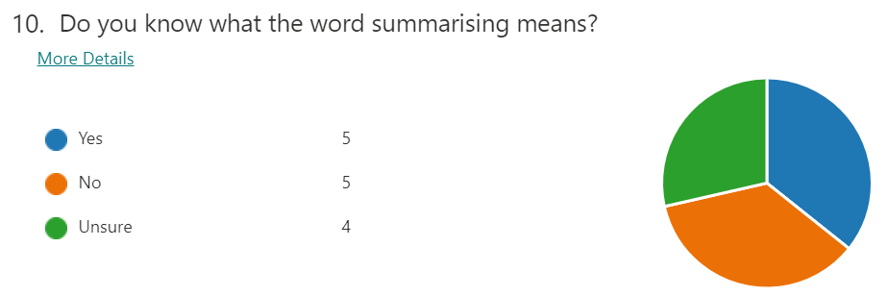
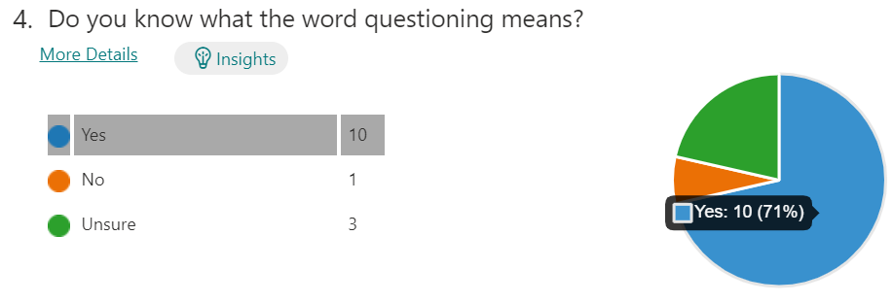
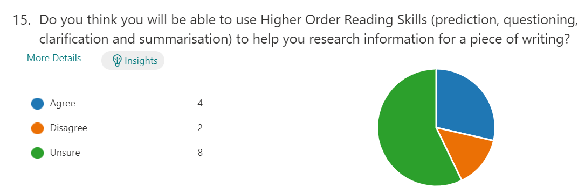
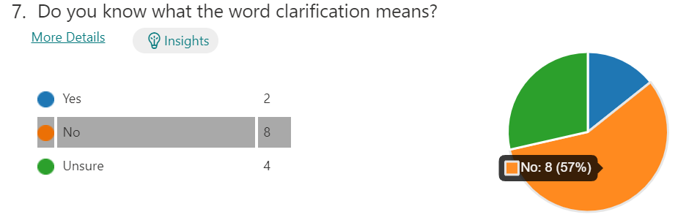
Pre-test questionnaire

Slide 10
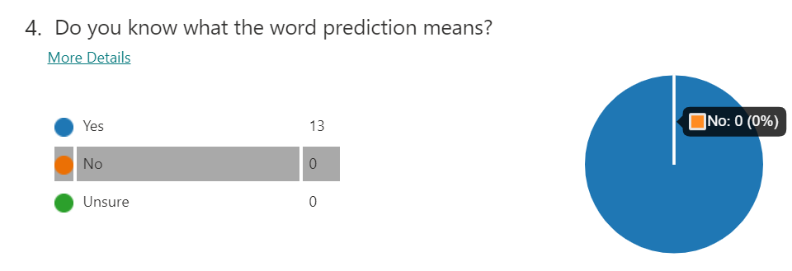
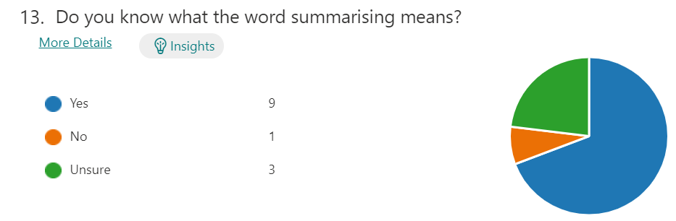
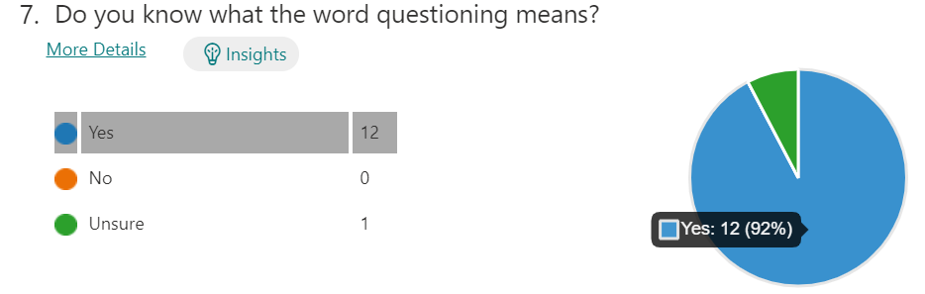
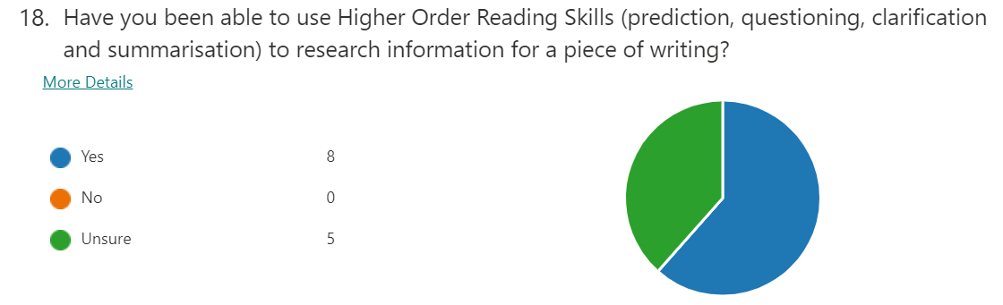
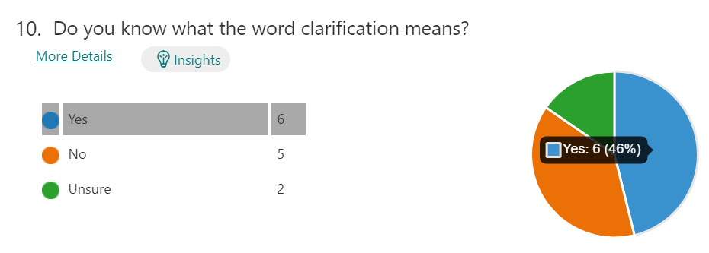
Mid-test questionnaire

Slide 11
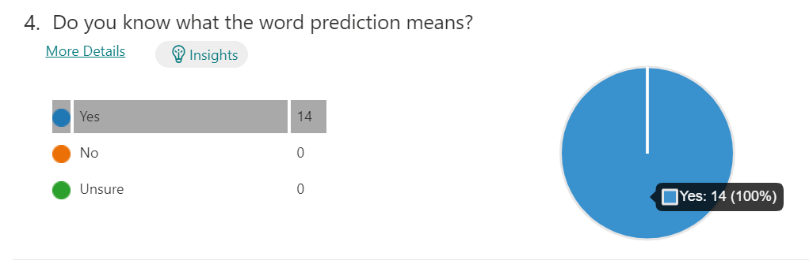
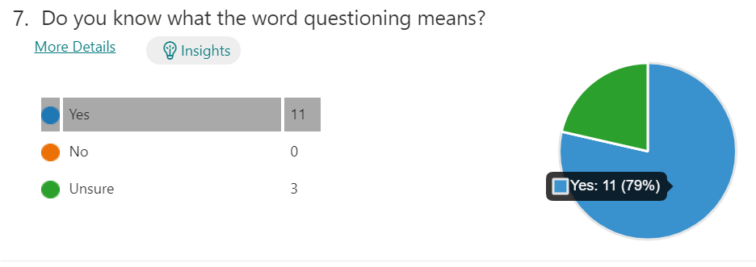
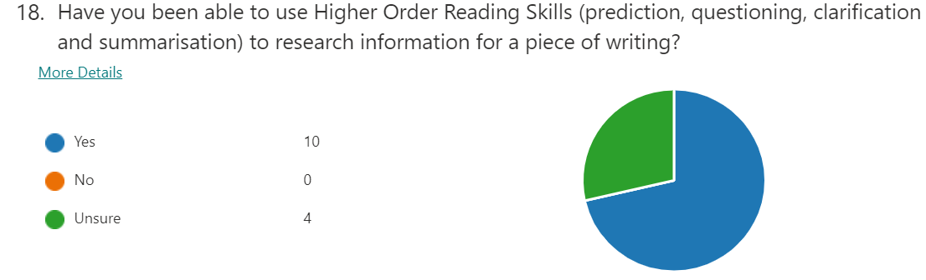
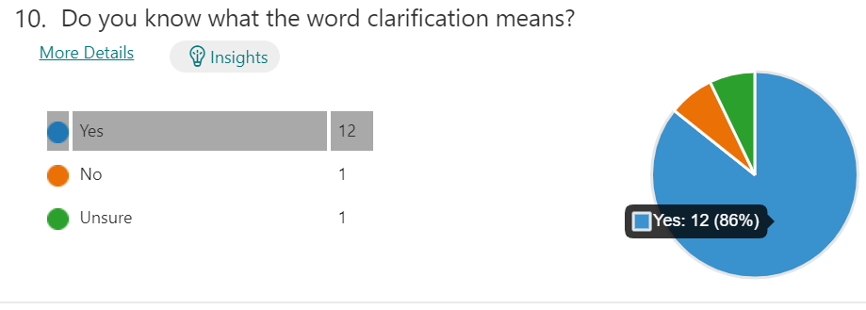
Post-test questionnaire

Slide 12
Focus group pupil interviews
The questions:
How do you think the HOR skills you’ve learnt, have helped you with non-fiction writing?
What do you feel the differences are between the first piece of writing and the last piece of writing?
How do you think the skills have changed your writing?

Slide 13
Responses
‘Back then we knew the information, but we didn’t know how to put it into our writing.’
‘I think it’s helped me because it’s made it easier to research and it’s helped us finding information – key information to help us write.’
‘It also helps us understand key information … and sift through it, to know what to use and what not to use.’
My vocabulary has expanded and I’ve learnt a lot more words.’
‘We are more capable [now] of writing about things that are non-fiction and about real-life.’

Slide 14
Data collection
All the pupils made at least
two sub-levels of progress in their non-fiction writing . One pupil made 4 sub-levels of progress.
A good achievement considering
the pupils were not in school
during the second lockdown period.

Slide 15
Analysis of results
The questionnaires and interviews show how the children in the focus groups became more confident in their understanding and use of HORs over the research enquiry period.
The assessment of three pieces of writing show an increase in confidence and attainment. Whilst progress is normally expected throughout the school year, remote learning would have impacted this. The clear progress between levels portray how HORs have positively impacted the children’s writing. It is possible that during a usual school year (no disruptions and remote learning), the children would have made even further progress in their writing.
The children have successfully learnt how to use these reading skills to help their writing. They enjoyed learning and using the HORs and using these to advance their writing.

Slide 16
The challenges faced:
There was an impact of remote learning on tasks specific for the research – some children did not complete the second task due to home learning, so comparisons were made between the first and third tasks only as not all data for the second task was available.
Remote learning also impacted the delivery and inclusion of the skills during the second task – it was much more difficult to revisit and practise these through remote learning and some pupils did not attend the sessions.
The second lockdown also delayed the start of the enquiry so the timescales remained tight from start to finish.
A couple of the teachers had not been involved in running a research-led enquiry previously so it was a steep learning curve for them.

Slide 17
What are you learning, individually and as a school, as a result of the enquiry process?
As the lead enquirer, I have learnt important lessons regarding the collection of data and need for consistent methods of approach and systems when gathering information.
There were four teachers involved in the project and two teachers have previously lead enquiry based research projects so naturally took the lead in directing the project. During the whole experience, in my role as lead enquirer, I have learnt so much from the university lecturer in regards to running a research project that I feel during the next project, I would be able to coach and support more teachers through their own enquiry-based research schemes as my knowledge of the enquiry-based research processes has developed and grown.
As a school we have observed, by the end of this research project, improved pupil attainment in writing over a relatively short period of time. As a result of this progress, the school will adopt new practices regarding teaching Higher Order Reading Skills more frequently and consistently for Year 5 and 6 pupils in order to draw on and apply the HOR skills when planning and writing non-fiction genres.
We have also learnt the importance of taking on new challenges and seeing a problem, trying out a solution and analysing the results. This project has allowed us to gain the skills to apply this cycle of improvement in a more formal, objective and consistent manner.
The school would be keen to continue this journey of discovery and to apply the research skills learnt to another research project and involve more teachers in the process.

Slide 18
What we would do differently in the future?
Whilst our research shows a clear correlation between the teaching of HORs to develop writing ability, there are a few things we would change in future research enquiries.
We would:
keep the same number of children in each focus group, for clearer comparison of data.
ensure consistency in the questionnaires through the different stages of the project by keeping the questionnaires confidential but named for data comparison purposes, although we appreciate when the children’s questionnaires are anonymous they are less likely to feel pressured with their responses.
ensure the training aspect of staff was of greater focus during the next project. Only the lead enquirer attended the research workshops and the other staff were not able to gain that same depth of knowledge regarding the enquiry process. For the next project, more time would be dedicated to imparting and cascading of knowledge to all the teaching staff regarding the research methods and the general process of running a research enquiry project.

Slide 19
How will we sustain and develop the culture of enquiry in our school?
As well as working on the NPEP HORS research project, St Padarn’s have been involved with a HEFCW-funded enquiry (2019-21) which entailed regularly sending home maths games with Year 2 pupils as a means of increasing parental engagement in their children’s maths work.
Our pupils have benefitted greatly from taking part in both enquiries and to sustain this culture of enquiry, we must embed the practices which have been found to be beneficial to the pupils. We will make arrangements to ensure the HOR skills are taught thoroughly in Upper Key Stage 2 and referred to when writing non-fiction genres to ensure the levels in writing continue to increase. Plus, the regular sending home of maths games will be rolled out to other year groups during 2021-22.
We are looking forward to being part in the NPEP project during the next academic year, ensuring more teachers can lead or be involved in research enquiry. As greater numbers of teachers and staff take part in future enquiry, more and more benefits will be encountered resulting in the development of a positive research culture.

Slide 20
We have thoroughly enjoyed researching and learning alongside our children and are looking forward to using what we have learnt in future research enquiries that encourage and nourish lifelong learning.
Thank you for taking the time to explore our findings.
Diolch yn fawr iawn.
As we follow in Jesus' footsteps, we grow in faith, love and learning.

