Slide 1

How does a variety of linguistic literary reading resources effect reading enthusiasm in a culturally diverse primary classroom?
NPEP 2022-23 Ysgol Padarn Sant
As we follow in Jesus' footsteps, we grow in faith, love and learning
Wrth gerdded yng nghamau Iesu, tyfwn mewn ffydd, cariad a dealltwriaeth.

Slide 2
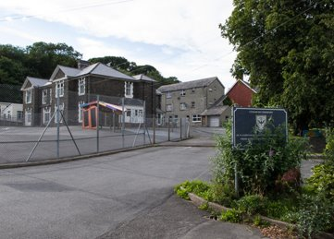
Ein hysgol ni – Ysgol Gynradd Gatholig Padarn Sant
Pupils on roll: 125
Free school meals: 17.1%
ALN register: 34.6%
EAL register: 22.4%
As part of a happy and culturally diverse community, nearly 1 in 4 of the children in our school speak English as an additional language.
Notes:
As you can see, nearly a quarter of children are registered as English additional language. Many other children also speak a variety of languages at home, with diverse heritage and cultures.

Slide 3
Supporting literature: Burnett and Merchant (2018).
‘… research over the last five decades in literacy studies has highlighted, certain kinds of literacies have always been valued more than others (Street, 2003). In educational provision, we know that this imbalance can have detrimental effects on many children’s present and future lives.’
‘…teachers of children and young people might usefully spend time investigating the diversity of texts with which their students engage, including popular and digital media. In this sense, our analysis supports longstanding calls for teachers to acknowledge and build on children’s out-of-school literacies.’
Notes:
The supporting literature emphasises the importance of literature that reflects all children’s lived experiences, languages and cultural heritage, and the importance of teachers acknowledging ‘out-of-school literacies’

Slide 4
Supporting literature: Stille and Cummins (2013)
‘…effective classroom instruction will draw upon the full range of students’ linguistic repertoires and diverse histories as a foundation for learning.
To these principles, we would add the idea that instruction that affirms students’ identities exerts a significant impact both on their self-image and the quality of their language learning’.
Notes:
These ‘out of school’ literacies build ‘foundations in learning’ and confidence in their learning trajectories in general, as it builds on their learning outside the classroom. Also known as ‘funds of knowledge’.

Slide 5
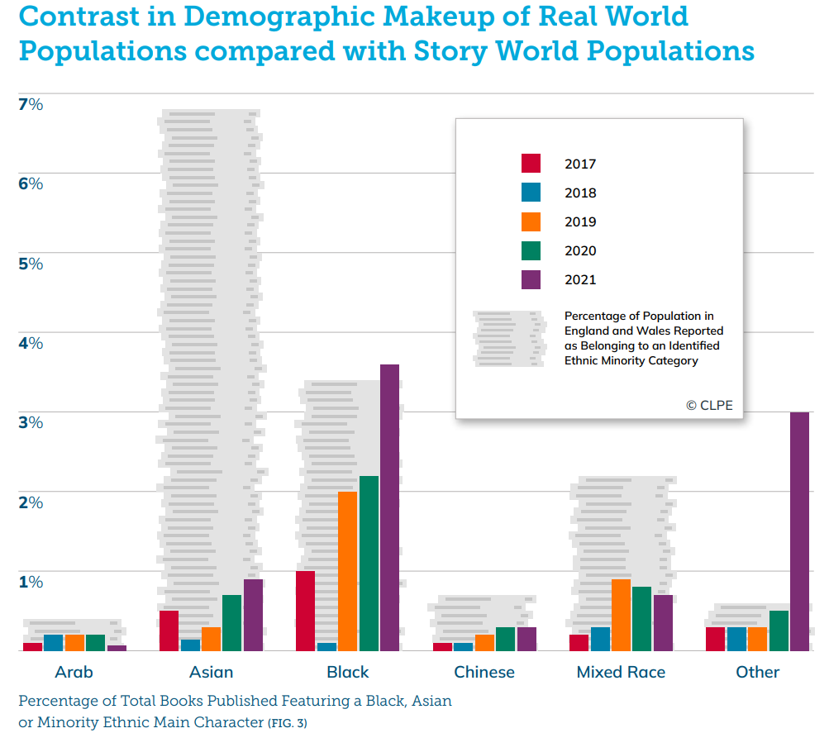
Diversity in literature: reflecting realities
(CLPE 2022 report)
Notes:
The Centre for Literacy in Primary Education released this graph representing ethnicities in real world population, and the number of books that represent these ethnicities. You can see that whilst there is some improvement, there still isn’t enough representation that reflect realities of many children in England and Wales.

Slide 6

Research design and methodology
Action research approach.
Objective to find out nationalities, cultures and languages represented and find literature that represented these children.
Originally designed our research with an idea of conducting research through a mixed method approach of quantitative and qualitative data collection.
Upon reflection, decided it would perhaps be more conducive in asking children open ended questions and using prompts as part of a semi-structured interview with teaching and support staff.
Notes:
We wanted to change something for the better in our school – and most research in school is actioned, and therefore action research. We decided to use qualitative data collection rather than quantitative, as we were asking them their views – the only way we could action the research was by acting on their contributions to the discussion.

Slide 7
Research design and methodology
As insider researchers, we have an established rapport with the participants.
However, it was important that we understand we should and could not make assumptions of languages children speak and read in, or would like to read in.
Notes:
For example, speaking languages but not reading in them and not neccesarily choosing books in languages they read in at home (ie French instead of Tamil).

Slide 8
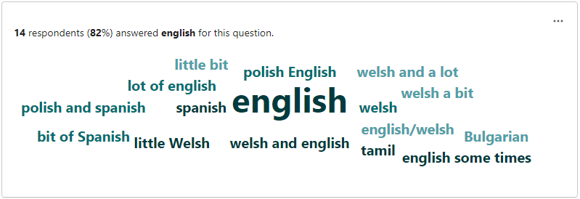
Findings from Questionnaires with Years 4 - 6
Languages spoken at home (1):
Notes:
Most children spoke English at home – however, many spoke an additional language to English as is shown here -

Slide 9
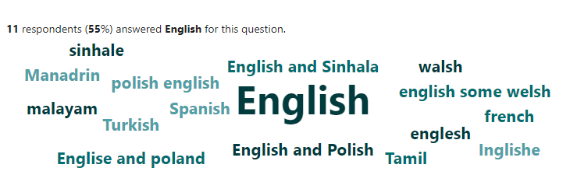
Findings from Questionnaires with Years 4 - 6
Languages spoken at home (2):
Notes:
The questionnaires provided a great foundation to prompt discussion with the children about who they spoke to in different languages, and why. For example, one child expressed that she felt it was important that she didn’t speak Tamil with a peer who also spoke Tamil, as she was only in the UK temporarily and it was important to develop her English. She was however, concerned that her younger sibling was ‘forgetting’ how to read and write in Tamil.

Slide 10
Languages read at home
We noted from the following responses that although many of the children spoke a variety of languages, confidently at home, their reading in those languages was sometimes less developed.
We wondered if this was because of the lack of linguistically diverse literary resources accessible to them.

Slide 11
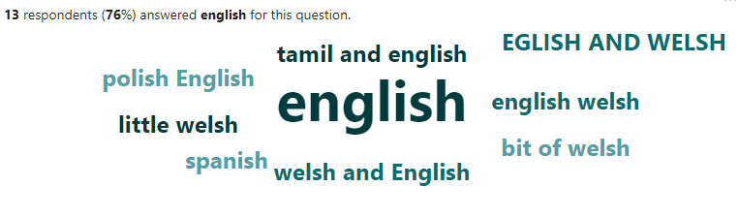
Findings from Questionnaires with Years 4 - 6
Languages they read in (1):
Notes:
Lots of children spoke fluently in another language but didn’t feel confident reading in that language. However, they expressed that they would like to be able to.

Slide 12
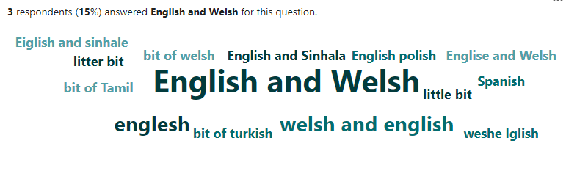
Findings from Questionnaires with Years 4 - 6
Languages they read in (2):

Slide 13
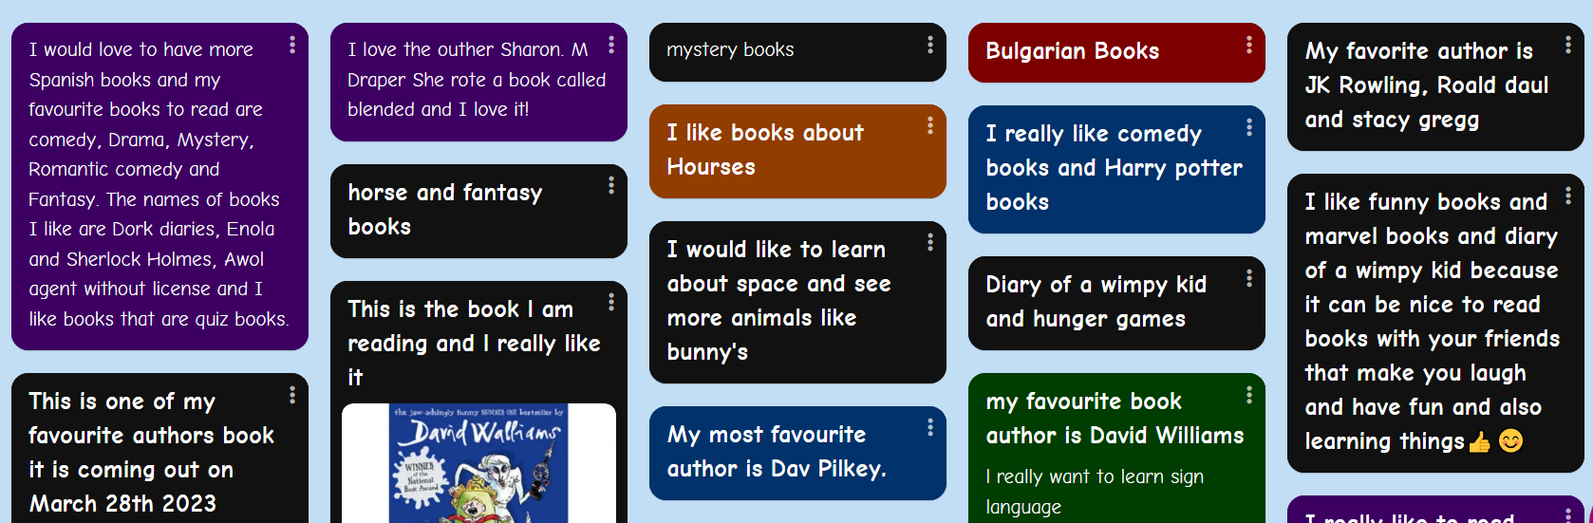
Findings from Padlet comments with Years 5 - 6
Kinds of books they would like in school:

Slide 14
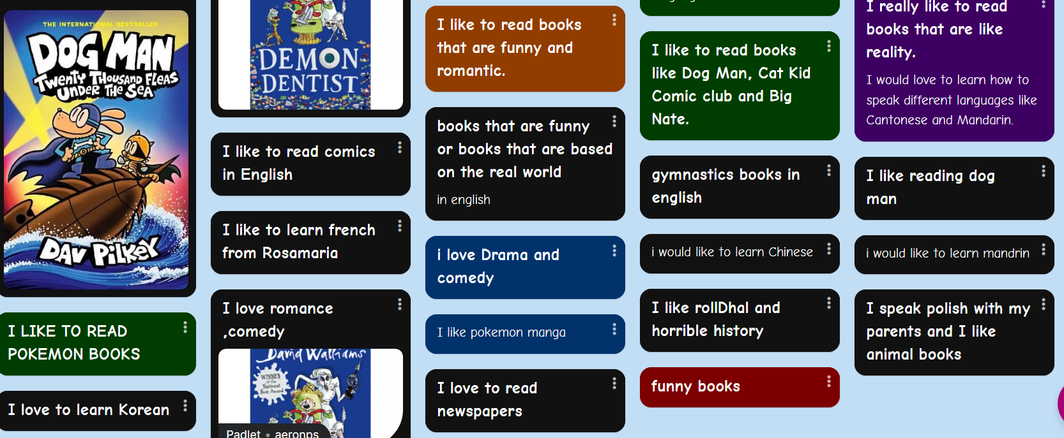
Findings from Padlet comments with Years 5 - 6
Kinds of books they would like in school:
Notes:
In addition, the children asked for poetry books, more African novels, and language learning books.

Slide 15
Research design and methodology
According to the ideas and views of the children and staff, we sought to provide a variety of literature in various languages and representative of a variety of cultures as possible before discussing with the children involved through semi-structured group interviews to examine the impact this had, in the summer term.
Limitations:
Difficulty finding some language books – e.g Sinhalese.
Difficulty finding some genres of literature in a variety of languages.
Estyn inspection before Easter holidays – research on hold.
Unable to fully assess reading ability of home languages.
Notes:
From these findings we began to source a variety of literature.

Slide 16
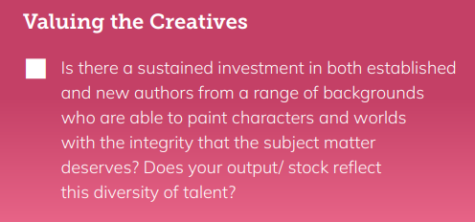
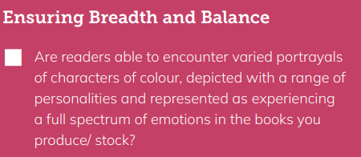
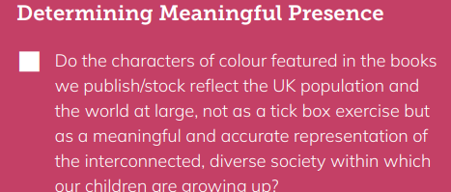
Guiding considerations for diversifying literacy resources in our school (CLPE)
CLPE report, 2022
Notes:
It was important to be aware of sensitivities, not making assumptions about the kind of books children would like, and that they truly reflected their realities rather than what we assumed would. The CLPE provided a good guiding point for sourcing diverse literature.

Slide 17

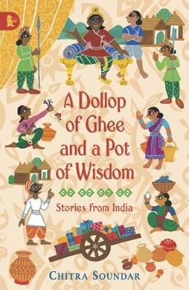
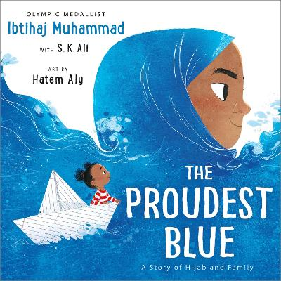


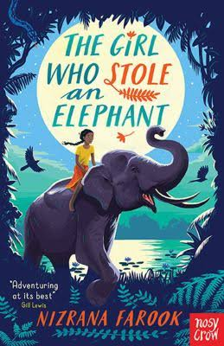




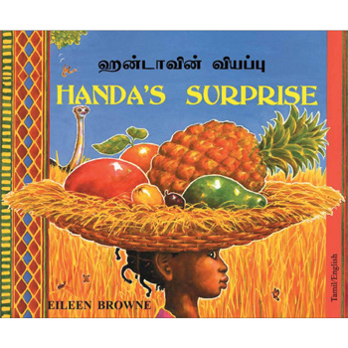
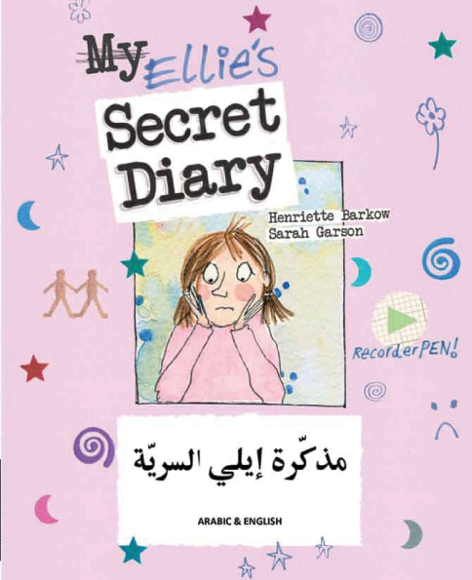

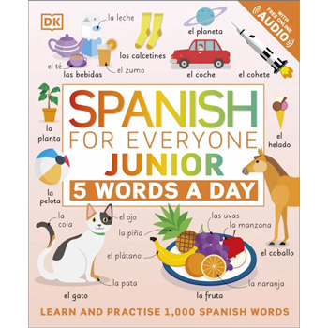
Literature examples
Notes:
Some of the books that we bought

Slide 18

Findings from second Questionnaires with years 4-6
"l love reading tamil books"
"I like to learn French"
Why did you choose the book you are reading?
"because am from Romania and I like Latin."
"because im half turkish"
Notes:
We are still in the process of collecting some of the data from the second round of questionnaires – but here are some of the responses we have had so far.

Slide 19
Findings from second Questionnaires with years 4-6
Are you enjoying the books? Why?
"yes I enjoyed the Romanian and Latin."
"French is fun to learn"
"I enjoy the book"
"I enjoyed how I could read my own language and the Latin was just fun and cool."

Slide 20
Findings from second Questionnaires with years 4-6
Do these books make reading ore fun (enjoyable) in school?
"YES FOR SURE"
"YES of course"
"YES."
"yes I think it is enjoyable"

Slide 21
Findings from second Questionnaires with years 4-6
Any other comments about the new books?
"Are there any learning 10 minutes of Tamil a day"
"there cool/fun/exiting/entertaining."
"it is because to know other languages"
"It is fun to learn other languages"

Slide 22
Additional findings
Questionnaires prompted impromptu discussions regarding their language use, where they liked to speak different languages and with whom.
For example, some children spoke Sinhala together in school, whilst some children didn’t speak to each other in Tamil as they felt they should be using the opportunity to develop their English skills.
Many of the children also expressed that they would like to have access to books that better represented them.

Slide 23
Staff discussion:
"In St Padarn's we have children with parents from: Romania, Poland, India, Sri Lanka, Ukraine, Nigeria, Ghana, Turkey, Belgium, Slovakia, Czechia, England, Northern Ireland, Spain, Taiwan and Wales."
"We think many children enjoy reading. They are keen to come into class and get their books out, they actively go to the reading corner."
"They enjoy having books on the playground."
"Factual books are a hit."
"They ask to listen to a story being read, enjoy sharing facts with the class, class are calm when it is story time at the end of the day, and they enjoy discussing their books with each other."
"Most children bring their reading books back, having read them at home."

Slide 24
Findings from staff discussion:
There are many nationalities and languages represented in our school, and these are recognised by all teaching staff.
Children in our school enjoy reading and being given the time and space to do so (for example, being able to take books onto the playground).

Slide 25
Staff discussion:
"The new books with different languages in are proving to be popular. Initially this may be a novelty so now waiting to see if this has a concrete positive effect."
"There is an issue that they can't keep them in their trays so they can't progress with reading one book."
"Due to the small number of books it is a bit of an issue – sharing/trying to keep the same book."
"The representation of different cultures is very important to our children - for example the Welsh scheme we use is very 'white European'."
"Audio books would be good – many of the children speak a language but are not able to read in that language."
"The boys in particular enjoy factual books – especially about WW2, space, animals, minibeasts. We would like some new chapter books (more updated), anime comic books, high interest but low-level reading materials for example the Diary of the Wimpy Kid – lots of pages but minimal text."

Slide 26
Findings from staff discussion:
More books needed – with a greater variety of genres.
In agreement that a variety of more culturally representative books should be available.
Access to audio books in a range of languages for children who can't read in their first / additional language confidently.

Slide 27
To conclude:
Although our research is continuing - so far, we have found that the children are really enjoying having access to more literacy resources that represent them and their realities better.
We will continue to source literature resources (including audio books) that represent all the children as best as possible in our school, to encourage our children to celebrate themselves and our community in all its diversity.
Our aim for this research is to help our school understand how we can continue to create an environment that is inclusive and encourages multilingualism.

Slide 28
Going forward:
As a reflexive research process, we have discovered there is so much more to explore…
We would like to involve parents to gain a better understanding of how we can encourage reading in a variety of languages at school.
To explore the impact this has on their language use amongst peers in school also.
How does reflecting their realities through literacy resources affect their learning?

Slide 29
References
Burnett, C. and Merchant, G. (2018), ‘Affective encounters: enchantment and the possibility of reading for pleasure’, Literacy: UKLA, 52(2), pp. 62-69.
Centre for Literacy in Primary Education (2022), ‘REFLECTING REALITIES’, Survey of Ethnic Representation within UK Children’s Literature 2017–2021, online: https://clpe.org.uk/system/files/2022-11/CLPE%20Reflecting%20Reality%202022%20WEB_0.pdf Accessed: 5.6.23
Stille, S. and Cummins, J. (2013), ‘Foundation for Learning: Engaging Plurilingual Students’ Linguistic Repertoires in the Elementary Classroom’, TESOL Quarterly, 3, pp.630 – 637.

